Slide 1
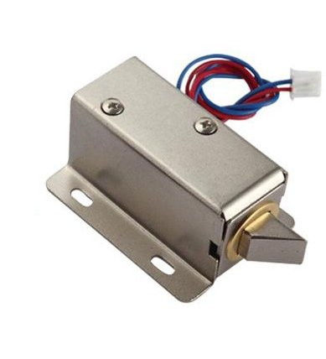
Solenoid

Slide 2
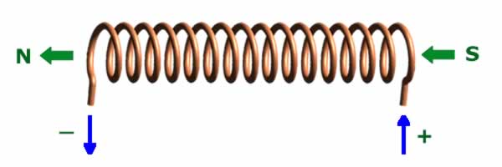
A Solenoid is a coil of wire, When current runs through that Coil of wire, creates a electromagnet. A solenoid is a type of electromagnet when the purpose is to generate a controlled magnetic field.
An electromagnetic actuator that converts an electrical signal into a magnetic field producing a linear motion is called the Linear Solenoid.

Slide 3
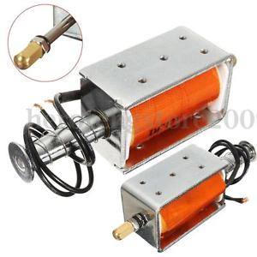
Linear solenoid’s basically consist of an electrical coil wound around a cylindrical tube with a ferro-magnetic actuator or “plunger” that is free to move or slide “IN” and “OUT” of the coils body. Solenoids can be used to electrically open doors and latches, open or close valves, move and operate robotic limbs and mechanisms, and even actuate electrical switches just by energising its coil.

Slide 4
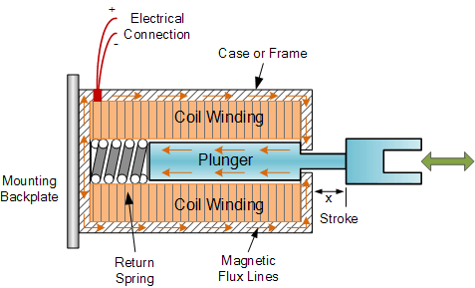
This type of solenoid is generally called a Linear Solenoid due to the linear directional movement and action of the plunger. Linear solenoids are available in two basic configurations called a “Pull-type” as it pulls the connected load towards itself when energised, and the “Push-type” that act in the opposite direction pushing it away from itself when energised. Both push and pull types are generally constructed the same with the difference being in the location of the return spring and design of the plunger.

Slide 5
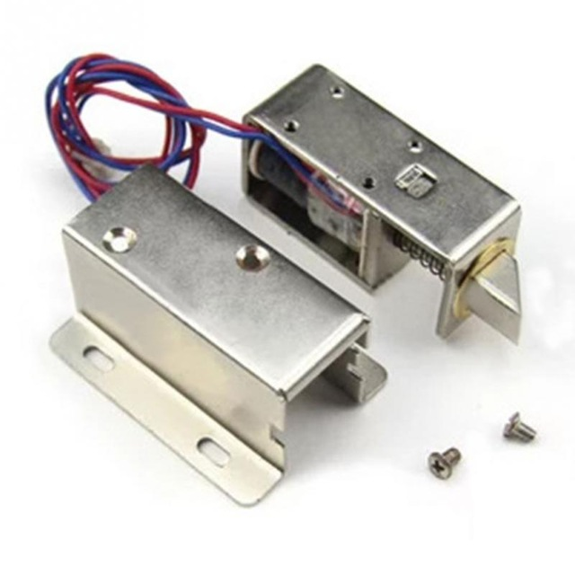
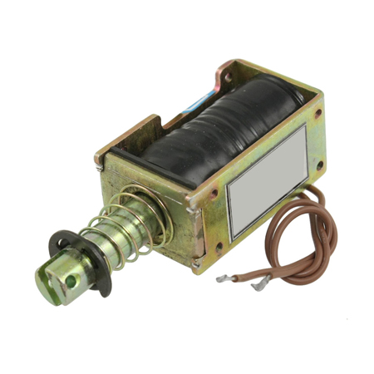

Slide 6
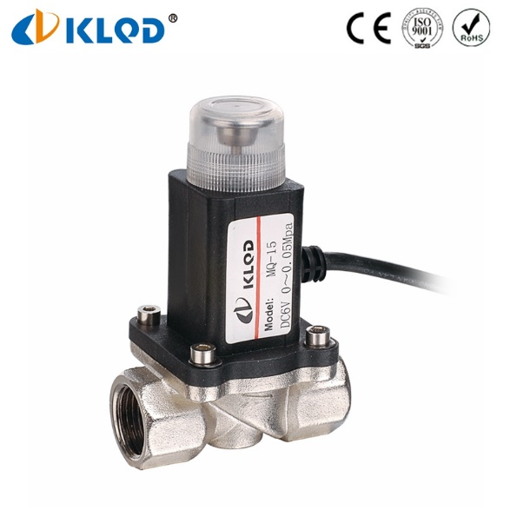

Slide 8
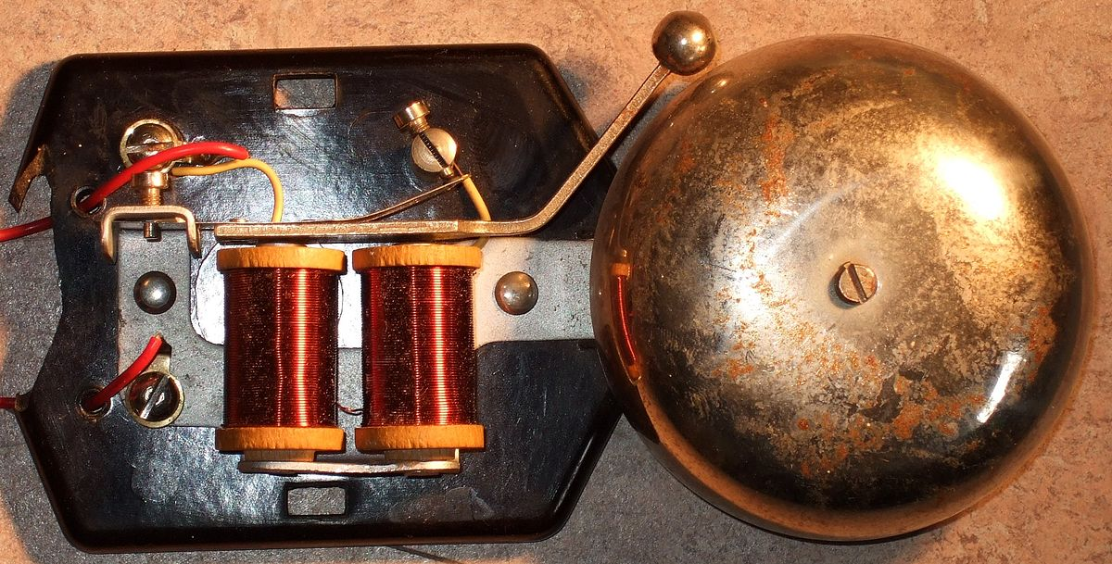

Slide 9
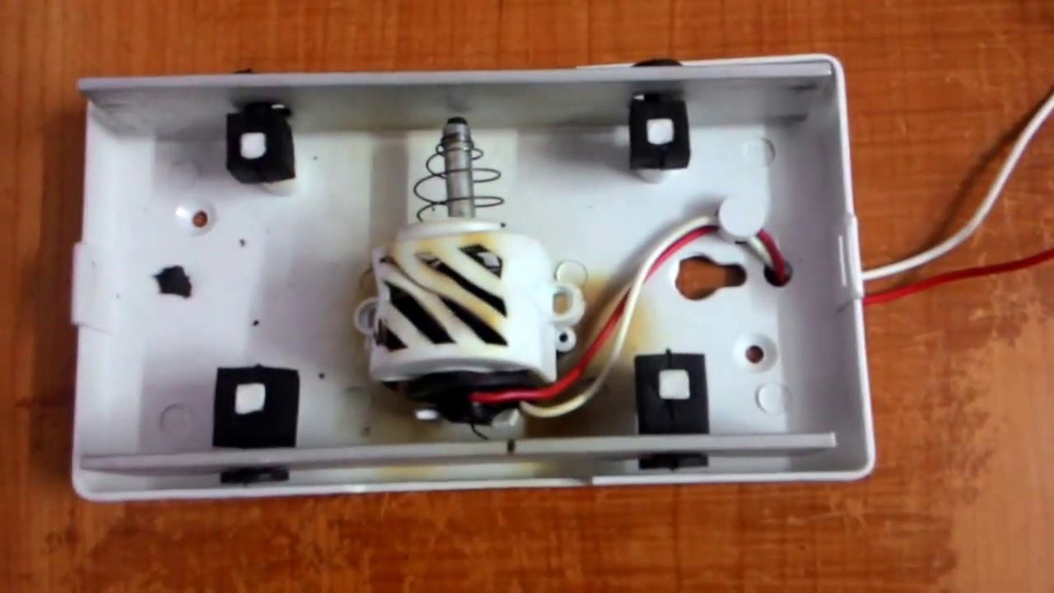

Slide 10
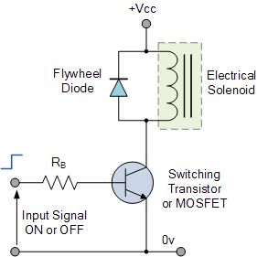

Slide 11
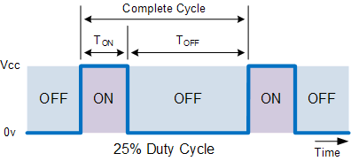

Slide 12
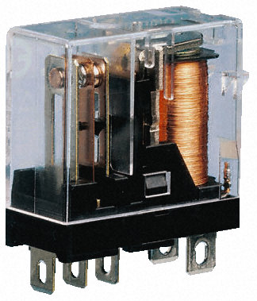

Slide 13
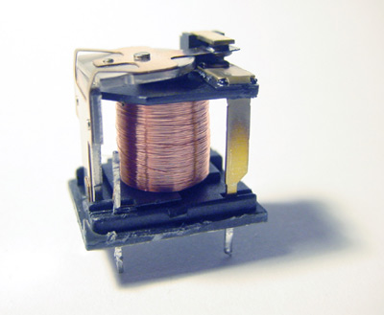

Slide 14
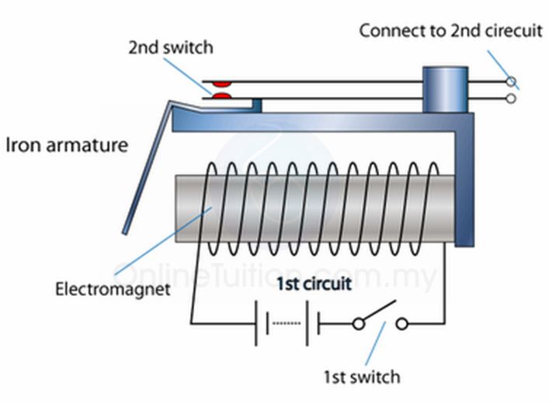

Slide 17
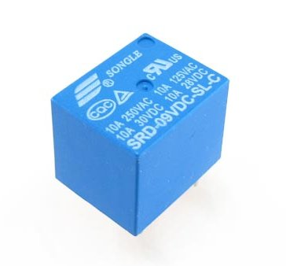
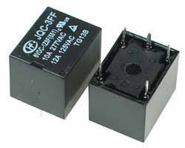

Slide 18
